Slide 1
Student Performance Prediction: A Multistage Approach via Interstage Relation Mining
(Tentative)
ZHAO Yuqing
csyzhao1@comp.polyu.edu.hk
Notes:
Under the projects of Multistage Data Analytics and Jockey Club

Slide 2
Outline
Background
Motivation
Problem Illustration
Challenge
State of the Art
Approach and Problem Modeling

Slide 3


Background
Hong Kong is in great need of educational data analysis.
With world-renowned universities; universities of all levels and directions of education
Improve education excellence, competitiveness and student performance, and reduce the waste of funds
Analysis of education data becomes difficult.
Conflict between old and new approach of data storage
Conflict between emergence of new data types and old analysis methods
Notes:
Hong Kong being a city with abundant educational resources and data needs educational data analysis.
Not only are there world-renowned universities, but also universities of all levels and directions of education can be found in Hong Kong.
To help improve education excellence, competitiveness and student performance, and reduce the waste of funds caused by unnecessary expenses.
With the emergence of technology such as online education, the analysis of educational data becomes difficult.
The old data storage approaches are not compatible with the new ways.
The emergence of new data types leaves the old analysis methods unable to achieve good results

Slide 4

Motivation
Student performance prediction
can indicate students’ performance, achievement of learning outcomes or characteristic.
in turn can help adjust teaching reforms, enrollment and school policies
Compared with other approaches, prediction predicts continuous valued functions, and can better analyze the overall structure of the education system rather than the local impact.
Notes:
Association Rule Mining, prediction, clustering, classification, Outlier detection, Text mining, Visualization

Slide 5
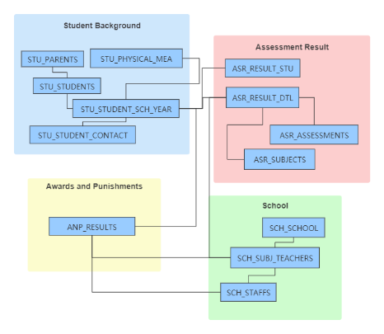
Problem Illustration
Assumption
Education systems inherit the characteristics of the multistage systems.
Different data recording systems can be regarded as substages/ subsystems.
These stages are separated from each other but are interdependent.
Input
Education data of a school/university
Objective
Student Performance (GPA, grades, fail or not)
Notes:
Physical status, grades, library check-in, rewards and punishment information, family status, online course login status, clickstream data, etc.

Slide 6
Challenge
How we can quantify multistage relation
Interstage relation; Relation between global objectives and substage features/objectives
How we can better incorporate time in and between substages
The education system is not static but rather change continuously: Generating of new data overtime. With the updating of school technology and the emergence of online courses, new datasets (substages) may be generated.
How we can analyze using multimodal data
As a complex system, there are multiple data types in the substages: Spatio-temporal data, time-stamped data, text descriptions, etc.

Slide 7
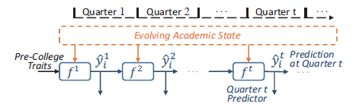
State of the Art
Data driven methods (Model education system as a single-stage)
Static Prediction [1][2]
Cons: Ignoring generating of new data and interstage connection
Progressive Prediction [3]
Cons: Adapting ensemble learning techniques and utilizing education-specific domain knowledge but ignoring connection of elements.
Fig1. Architecture of progressive prediction. Prediction results of the previous quarter can be utilized in the prediction of the current quarter.
[1] Buniyamin, Norlida, Usamah bin Mat, and Pauziah Mohd Arshad. "Educational data mining for prediction and classification of engineering students achievement." 2015 IEEE 7th International Conference on Engineering Education (ICEED). IEEE, 2015.
[2] Chen, Jiaming, Liming Luo, and Jie Song. "Course performance prediction for basic courses of universities based on support vector machine." Journal of Physics: Conference Series. Vol. 1168. No. 3. 2019.
[3] Xu, Jie, et al. "Progressive prediction of student performance in college programs." Proceedings of the Thirty-First AAAI Conference on Artificial Intelligence. 2017.

Slide 8
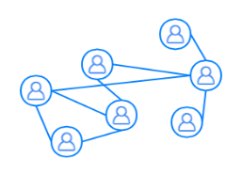
State of the Art
Graph-theoretic methods[4][5] (Fully connect every element of a single-stage)
Social Learning Network (Network between learners, teachers, and subjects)
Cons: Requires full knowledge about microscopic details. Hard to compute for large and complex systems. Ignoring the connection of different elements.
Network Topology
Data preprocessing
Features
Model Learning
Fig2. Summary of the SLN link prediction methodology
[4] Yang, Tsung-Yen, Christopher G. Brinton, and Carlee Joe-Wong. "Predicting learner interactions in social learning networks." IEEE INFOCOM 2018-IEEE Conference on Computer Communications. IEEE, 2018.
[5] Brinton, Christopher G., and Mung Chiang. "MOOC performance prediction via clickstream data and social learning networks." 2015 IEEE conference on computer communications (INFOCOM). IEEE, 2015.
Notes:
Graph: Predicting Learner Interactions in Social Learning Networks

Slide 9
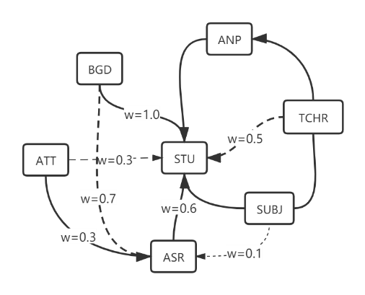
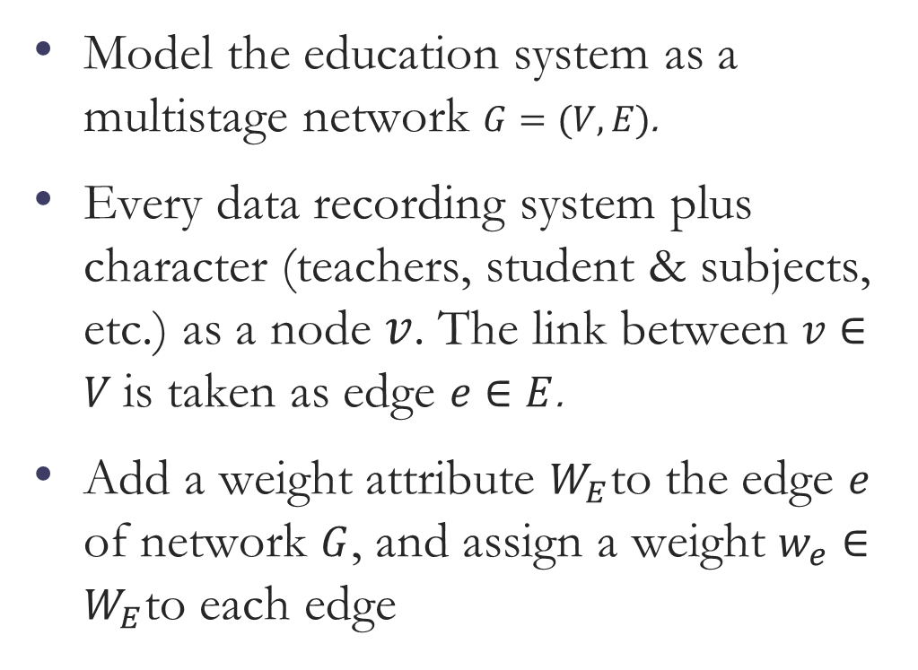
Approach and Problem Modeling
Model the education system as a multistage network ­$G=(V,E)$.
Every data recording system plus character (teachers, student & subjects, etc.) as a node $v$. The link between $v∈V$is taken as edge $e∈E$.
Add a weight attribute $W_{E}$to the edge $e$ of network $G$, and assign a weight $w_{e}∈W_{E}$to each edge

Slide 10
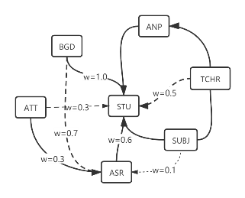
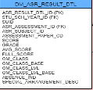


Approach and Problem Modeling
Use association rule mining for link weight prediction.
Extract weight, neighborhood and path features for prediction model.
Time Series Features
Neighborhood
Features
ASR
Association Rule Mining
Feature
importance
Prediction Model
Weight
ATT
ANP
Path Features

Slide 11
Significance and Impact
It can help better incorporating time in network-based studies and understanding large scale relational data.
Can be applied to various education systems and can even adapt to the update of the education system.
It could be further extended to benefit other multistage systems

Slide 12
Preliminary of Jockey Club Education Data

Slide 13
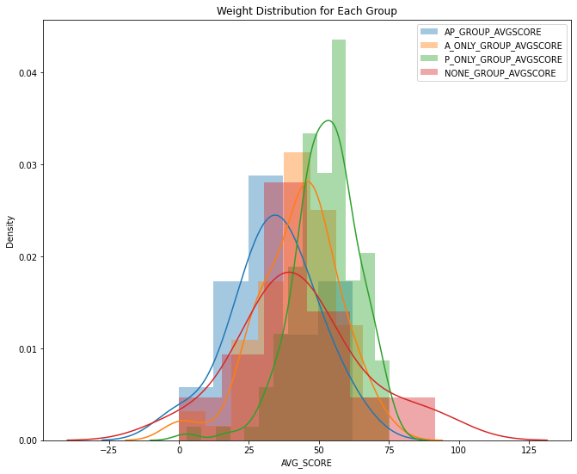
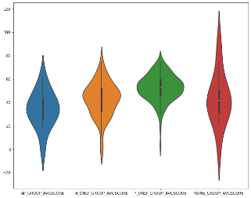
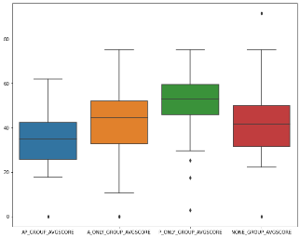
Progress

Slide 14
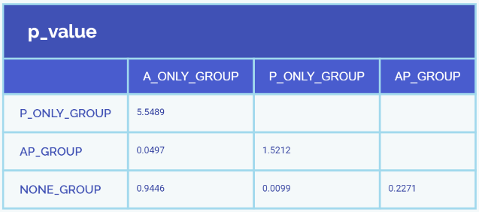
Progress
Notes:
P_value<0.05
This indicates that there are statistical significant differences between data groups

Slide 15


